Slide 1
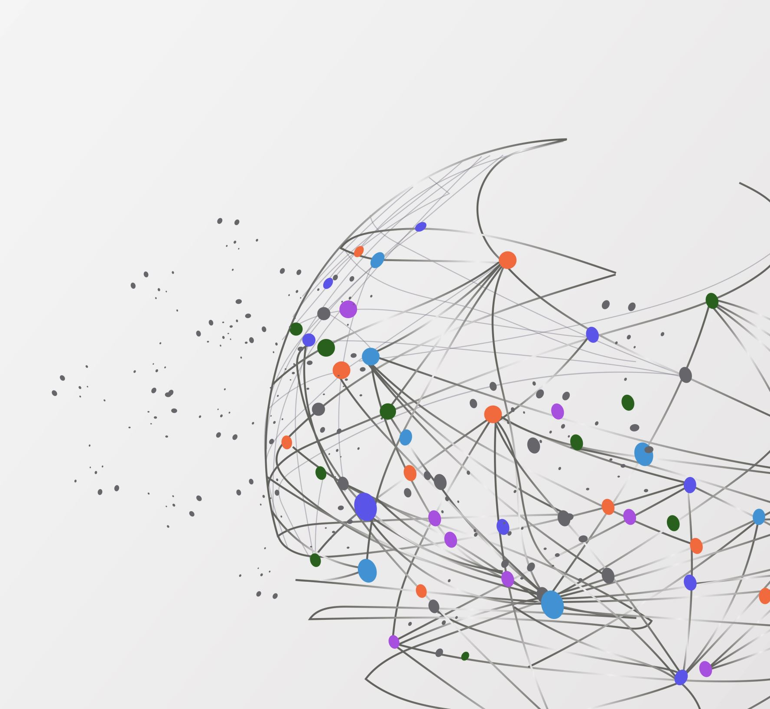
Customer Segmentation and Marketing Campaign Response Prediction
Charles Apaw
28/09/2024

Slide 2
Business Problem:
Objective: Predict whether a customer will respond positively to future marketing campaigns and group customers into meaningful segments based on their behaviour and demographic features.
Target Variable: The column Response, which indicates whether the customer responded to a campaign.

Slide 3
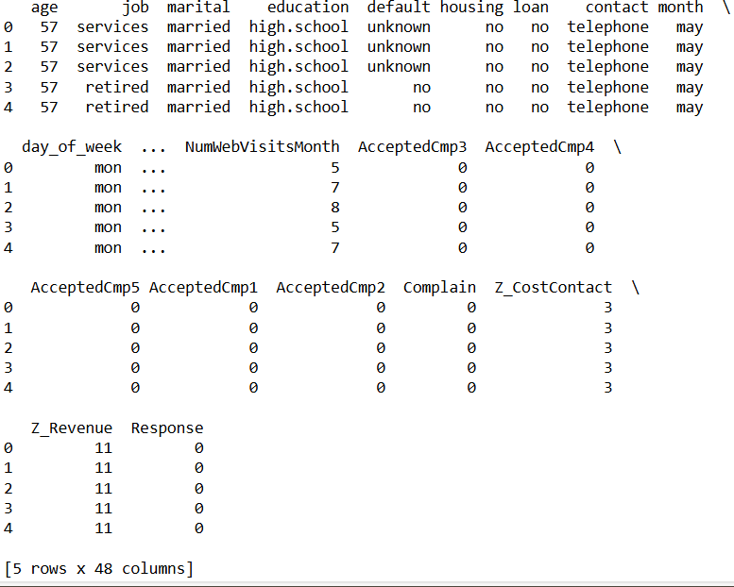
Data Overview
Bank Marketing Data: Contains information about past marketing campaigns.
Customer Demographic Data: Includes demographic features like income, education, and spending behavior.

Slide 4
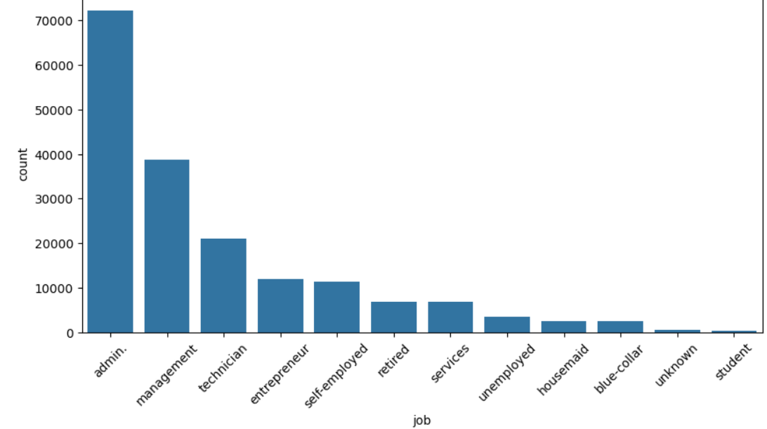
Job Distribution

Slide 5
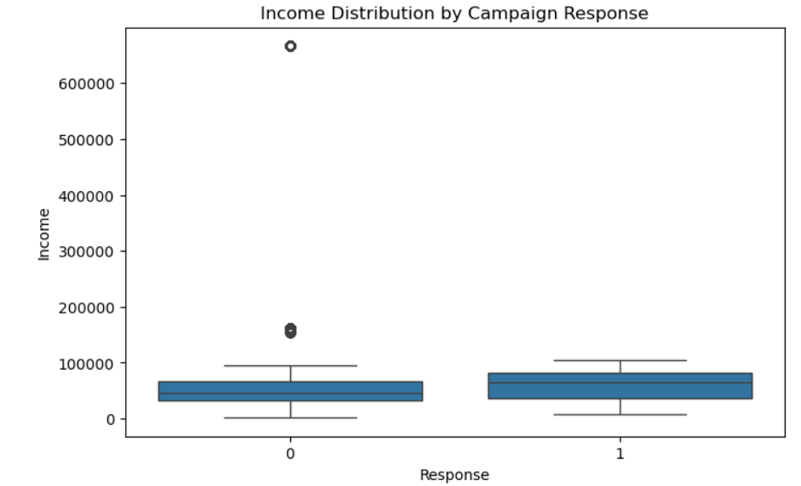

Slide 6
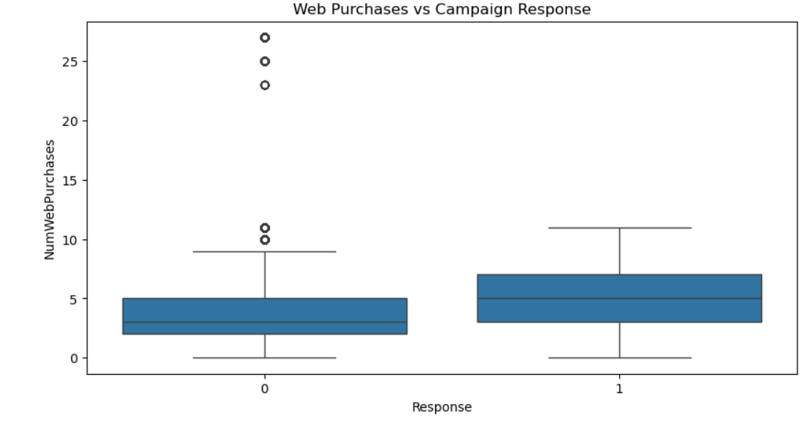

Slide 7
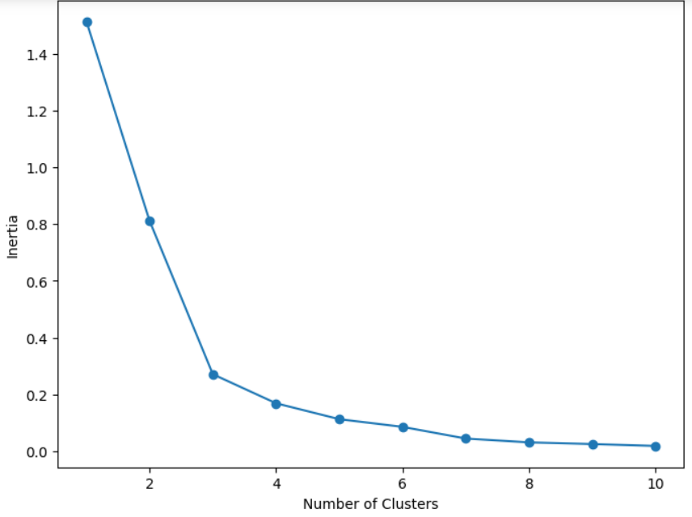
Unsupervised Learning
Elbow Method
Notes:
To better target marketing strategies, customers were grouped into segments based on age, income and behaviour.

Slide 8
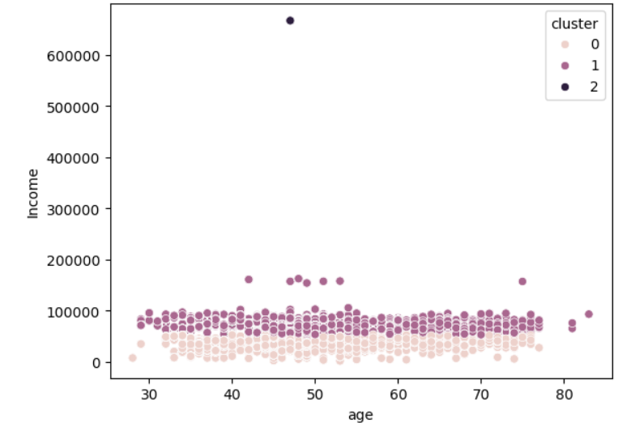
K- Means Clustering

Slide 9
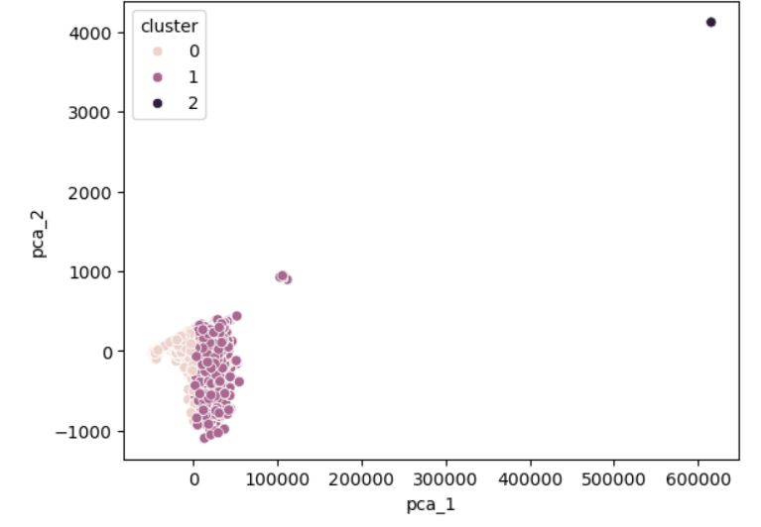

Slide 10
Supervised Learning
Full dataset
Training Set (70%)
Testing Set(30%)

Slide 11
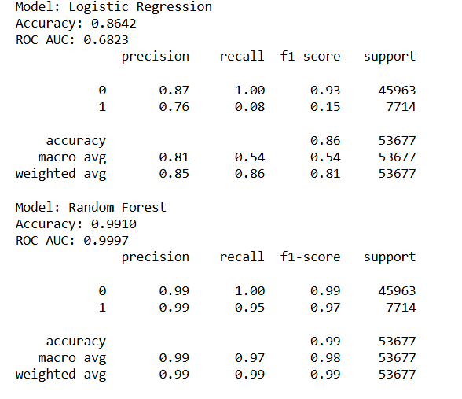
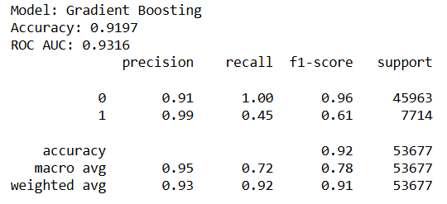

Slide 12
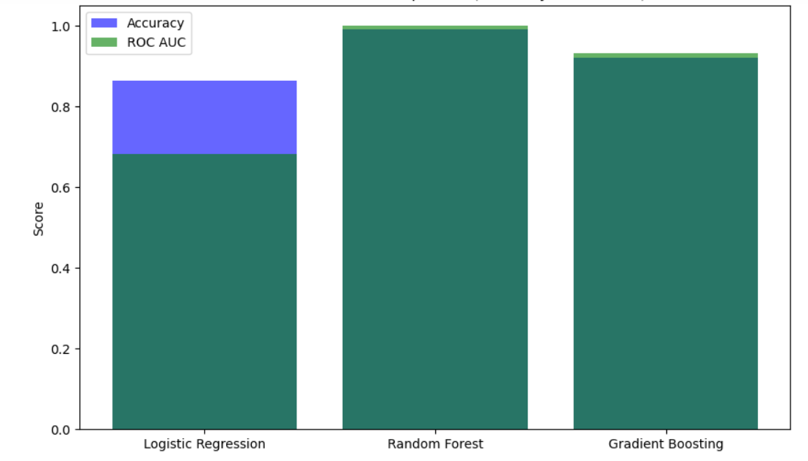
Model Performance Comparison

Slide 13
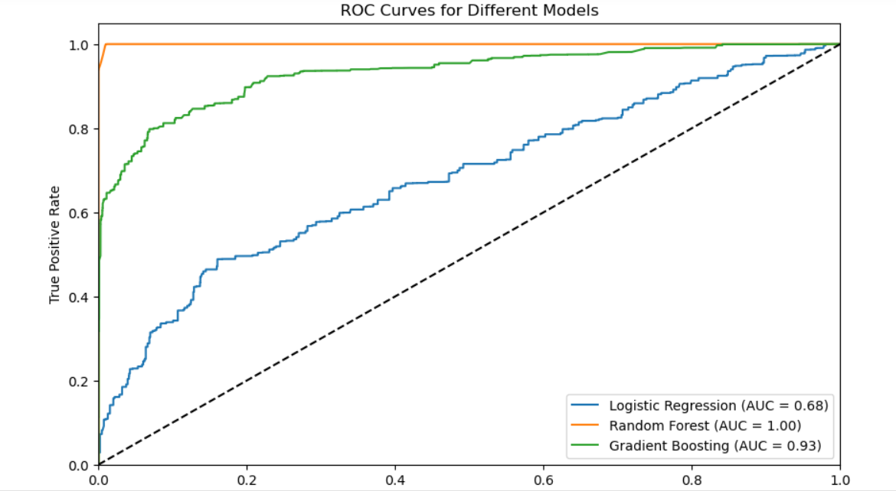

Slide 14
Business Insights and Recommendations
Customer Segmentation: The three customer segments provide valuable insights for tailored marketing strategies:
Low-Income Group: Budget-conscious; consider offering discounts and promotions.
Middle-Income Group: Average spending customers; targeted campaigns with loyalty programs.
High-Income Group: Affluent customers; premium offers and exclusive deals may work well here.
Marketing Strategy: Use these customer segments to personalize future campaigns and allocate marketing resources effectively.

Slide 15

Thank You! Any Question?

